Slide 1
Events
Srikar Mylavarapu

Slide 2
Questions from a time past
-- init properties
* If two or more anonymous object initializers in an assembly specify a sequence of properties that are in the same order and that have the same names and types, the compiler treats the objects as instances of the same type. They share the same compiler-generated type information.
-- what level do anonymous types get disambiguated at
C# Anonymous Types – Tutlane Method it’s initialized in

Slide 3
Event Theory
Medical System Cruelty
Time to do something
Resident’s Pager
Being a good resident, s/he decided to sleep through the pager… Their Attending decided to use the nuclear option

Slide 4
What do we need to get to this System
Medical System Cruelty
Resident’s Pager
Resident’s Cell Phone
Email

Slide 5
What do we need to get to this System
How do we keep track of who to notify?
Medical System Cruelty
What Method’s do we need
Can the messages be different?
Resident’s Pager
Resident’s Cell Phone
Email

Slide 6
Observer Pattern
This is a direct implementation of the Observer pattern. Maybe Tate will say, “This guy Jeff covered it” and skip it

Slide 7
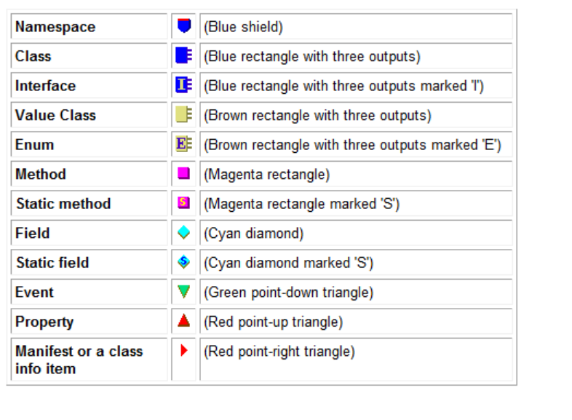
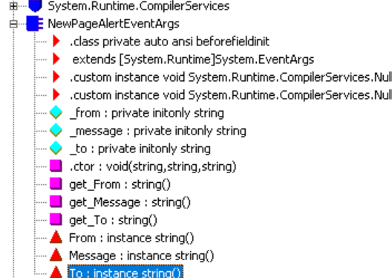
What should our message contain?
Class contains ‘EventArgs at end’
Inherits Event Args → wrapper class around Object

Slide 8
Oh Ildasm

Slide 9
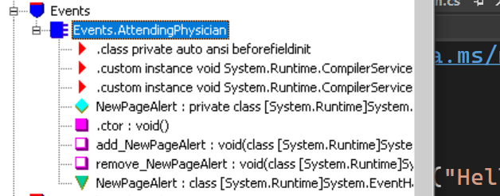
It’s called event’s aint it
Create a class that’s got an envent
What should the visibility of that member be?

Slide 10
Define a method to raise the event

